Slide 1

Explore new features of
Version 5.80 (5.70/06-11)
        CAD + CAM Plus + CAM Service tools

Slide 2
Basic-----------------------------------------------
GENERAL

Slide 3
Contens Page 1 (General)
General
    Windows 10 supported (5.70/5)
    Photoshop connection plug-in now supports newest Photoshop CC 2017 (5.70/10)
    PDF Onfly calculation performance by splitting into sub threads was increased (5.70/11 + 5.80/00) Page 4

Slide 4
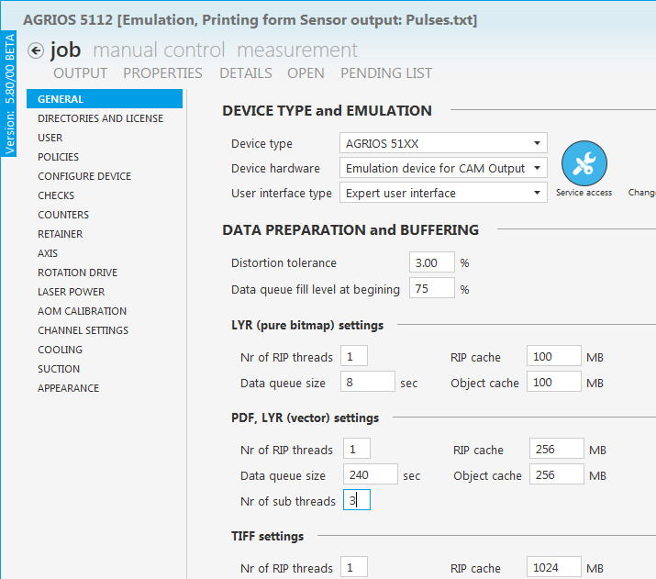
    BASIC - PDF ONFLY calculation performance improved (5.70/11)
Due to the current problems with PDF on-fly, improvements has to be done to increase the RIP performance. In the Beta version 5.70/11 an option was implemented, into how many extra threads the PDF on-fly calculation will be split.
The Nr. of sub thread is only considered for PDF‘s files and if the Nr. of Rip threads is 1. (variLEX, smartLEX, DLX).
With more than 1 RIP thread, the sub-threads make no sense, because the Device PC has too few processors.
Furthermore, it makes no sense to enter more than 3 Rip threads (Multichannel AGRIOS), because the Device PC has only 4 processors. The experience shows that the computer power for data output is still enough with an adjustment of 3 Rip threads.
An adjustment from 0 or 1 corresponds the default (no splitting to sub threads!)

Slide 5
    BASIC - Comparision between i5 and i7 Processor (5.70/11-5.80)
  i7 vs i5, Auto engraving PDF = 12% faster (ø from all PDF‘s )
  i7 (3 Subthreads) vs i5 (3 Subthreads), GAEZ Jobs = 7% faster
  i7 (7 Subthreads) vs i5 (3 Subthreads), GAEZ Jobs = 21% faster

Slide 6
Basic-----------------------------------------------
BASIC

Slide 7
Contens Page 2 (Basic)
Basic CAD & CAM
    Hide unused devices in the …
                … Settings to hide or show devices in the Job editor, Production calibration, CAM-Output emulation Page 8
                … 3D Relief calibration Page 9
    Production calibration:
  Fix gravure position should not fix gravure dimension Page 10
  New default production calibration data sets for rotaPlate on variLEX machines (5.70/07)
    Optimize dots below a defined value (5.70/07) Page 11
    Import colour information during open ESKO tiff-Files (5.70/07) Page 12
    Import LEN files ("Basel Scheel Laser graphics“) beside ESKO LEN files (ONLFY output is supported) (5.70/07)
    Several Background processes (5.70/07) Page 13-18

Slide 8
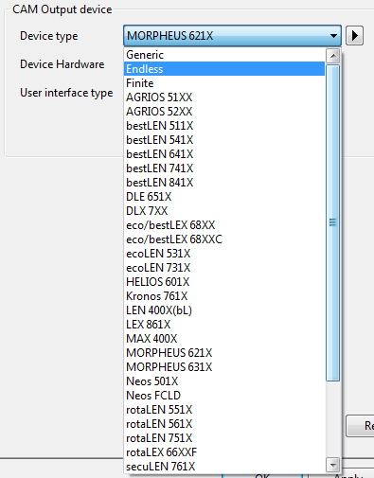
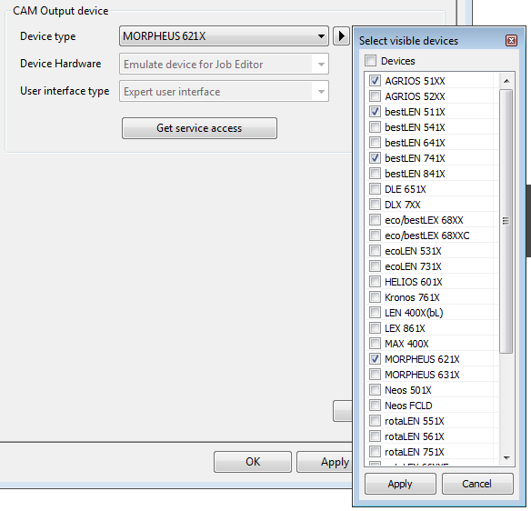
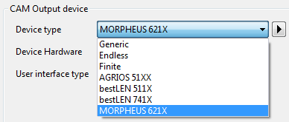
BASIC - Hide unused devices
Settings
  Normally a whole list of all devices is visible. For a better overview of all used devices it is possible to hide all unused devices in Settings – Device list.
  This adjustment is also adapted in the device list of the Job-Editor and Production calibration.
    Open the “Extra-Settings” dialog an choose “Devices”.
    Click on the arrow button to open a list of all devices and activate the check box of all devices you want to have in a list.
    Confirm with “Apply”.
    Now only activated devices are available in several device lists (Settings, Job-Editor, Production calibration)

Slide 9
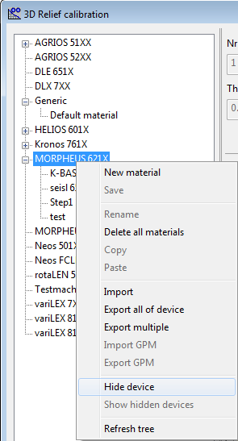
BASIC - Hide Unused Devices
3D Relief calibration
  Normally all graphical devices are visible in the 3D Relief calibration dialog.
  A selected device can be hidden from the list with context menu “Hide device” and shown again with “Show hidden devices”

Slide 10
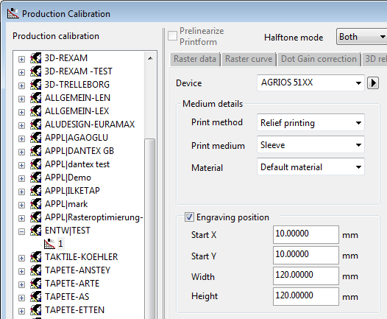
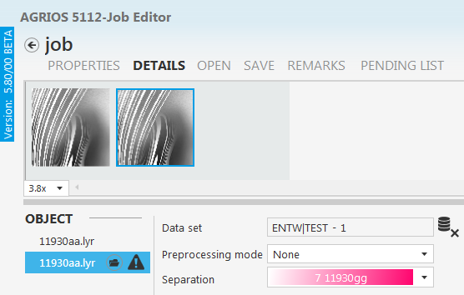
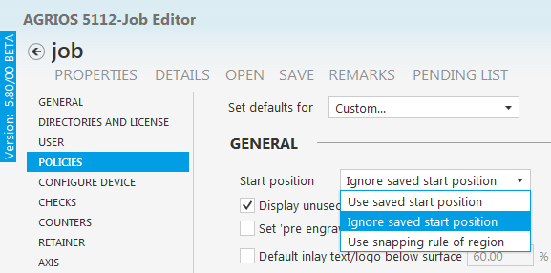
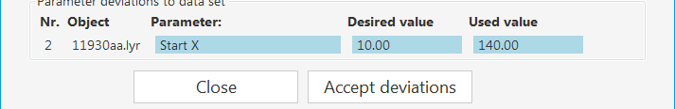
  BASIC - PRODUCTION CALIBRATION
Fix position should not fix dimension
Until now a data set with a fixed “Engraving position” has additionally fixed the dimension.
If this data set was loaded for objects in the CAM-Plugin,
objects which were moved to an other position were signed as “not synchronized” and Warnings were entered in the Warning dialog.
With an active “Ignore saved start position” in the “Policies” the check functionality of the position will be eliminated (the dimension will be still checked) , the data set will be shown as “synchronized“ and no warnings will be available.

Slide 11
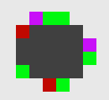

Basic - Optimize dots below improvements (5.80/00)
  Optimize dots below a defined value and a new calculation mode was implemented to prevent visible steps of a graduation especially in bright areas (from 1%-10% variable)
  Now 4 Modes are available in the Production calibration, Output parameter and Raster list to save them for the on-fly engraving.
  → None: (this mode was set automatically for textile devices)
  → Normal: ( this mode was set automatically for graphical devices)
  Until version 5.80 it was not possible to change the optimization value. This value was set by default onto 5%. Now it is possible to change this value from 1% -10%
  → Auto none/normal: This mode will be set automatically during loading old jobs where no optimizing was stored. Depending on the used Printing method (Screen printing, Relief or Gravure printing the Auto mode is set automatically to “none” or “normal 5%”.
  → Advanced: = new calculation mode.
  The dot growth is regularly with this method.
Dot growth from Shading 9 until 12 with the Old (normal) and New (advanced) mode
Normal Advanced
Shading 9 = black
Shading 10 = rot (+2 Pixel) (+2 Pixel)
Shading 11 = green (+5 Pixel) (+2 Pixel)
Shading 12 = violet (+2 Pixel) (+1 Pixel)

Slide 12
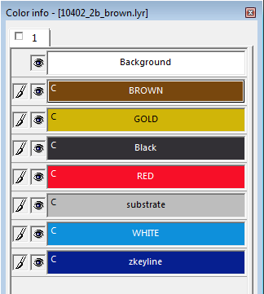
    BASIC - IMPORT COLOUR INFORMATION of ESKO Tiff-FILES (5.70/07)
The stored colour information (colour and name) of ESKO Tiff-files is taken over into the LYR-Files, during importing.

Slide 13
    BASIC - BACKGROUND FUNCTIONS (5.70/07)
New command line options for Run-Action
Following a list of the new options for starting bestIMAGE Background Jobs from the command line is shown. This commands can be combined with others:
    Specify an Output folder
    Compress Tiff Files after conversion
    Set PDF preset during importing PDF
    Scale multiple TIFF or Lyr Files
    Remove Source or Intermediate files

Slide 14
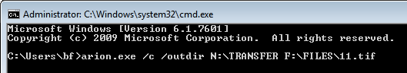
BG function – Specify the Output folder
/outdir: Specification of the output directory where the files after the conversion, compression, scaling…. are to be created.
arion.exe /c /outdir “Output path+folder” “Source path+folder”
The example shows the conversion (/c) of a Tiff file (F:\FILES\11.tif) to a Lyr file into a specified directory (/outdir “N:\TRANSFER”).

Slide 15

BG function – Compress Tiff Files after Conversion
/comp: The existing Tif files is compressed (LZW). This option can only be used with the command "/ctif".
arion.exe /ctif /comp “Source path+folder”
The example shows the conversion (/ctif) of a lyr file to a tiff file (F:\FILES\11.lyr) with subsequently compression of this tiff files.

Slide 16
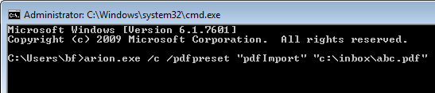
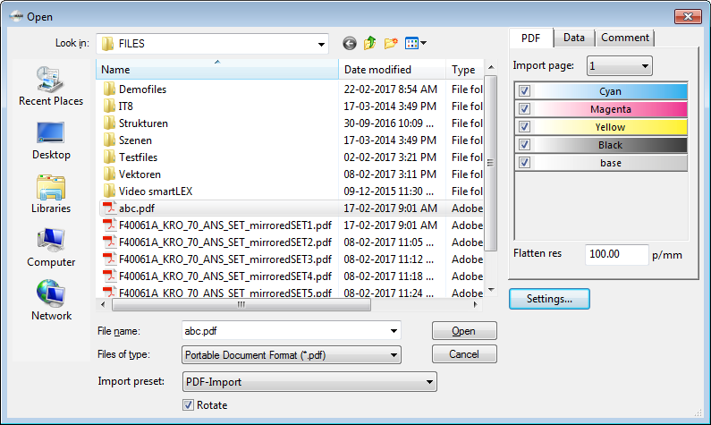
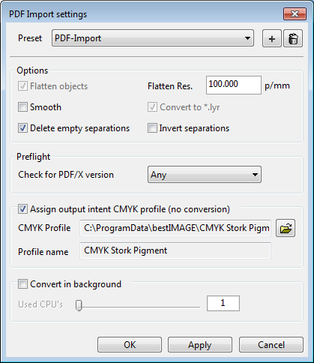
BG function - Set PDF Pre-set
/pdfpreset: Command to set a predefined preset during importing a PDF file.
arion.exe /c /pdfpreset “PDF-Import” “c:\inbox\abc.pdf”
The example shows the converting of the PDF file (abc.pdf) to a LYR-File (abc.lyr) based on the predefined preset of the PDF settings (PDF-Import).
Tip: To import CMYK separation activate “Delete empty separations” in the Presets of the PDF.

Slide 17
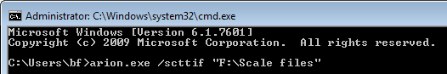

BG function - Scale multiple TIFF or Lyr Files
Command (“/sct”) to scale together all TIFF or LYR files of a specified directory to the largest size off all, to be able to combine files during opening after raster process which has different size/resolutions (due to different raster, angle or correction).
These command was implemented only for visually checking of files after rastering. This commands can not be combined with /rst (raster) /fp (3D relief calculation)
/scttif: Command to convert all TIFF files to the same size.
After finishing the BG process several intermediate files were created to obtain scaled tiff files.
arion.exe /scttif “F:\Scale files”
  Tif files are converted to lyr xxx.tif (source file) → xxx.lyr (= intermediate file)
  Lyr files are scaled to the largest file xxx.lyr → xxx_Scale.lyr (= intermediate file)
  Scaled lyr file is converted to file xxx_Scale.lyr → xxx_Scale.tif (= destination file)
/sctlyr: Command to convert all LYR files to the same size.
After finishing de BG process the folder includes the source and destination files.
arion.exe /sctlyr “F:\Scale files”
                Lyr files are scaled to the largest file xxx.tif (source file) → xxx_Scale.tif (= destination file)

Slide 18
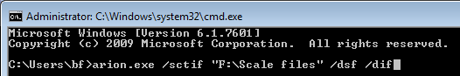
BG function – Remove Source or Intermediate files
So that no source or intermediate files exists after finishing a background process following commands can be given additionally to delete those files to have only the destination file
/dsf-/dif: Commands to delete all Source and/or Intermediate files after the background process (conversion, compression, scaling…). Only the destination file still remains.
arion.exe /scttif /dsf /dif “F:\Scale files”
                Tif files are converted to lyr xxx.tif (source file) → xxx.lyr (= intermediate file)
                Lyr files are scaled to the largest file xxx.lyr (interm. file) → xxx_Scale.lyr (= intermediate file)
                Scaled lyr file is converted to file xxx_Scale.lyr → xxx_Scale.tif (= destination file)
The example shows the scaling of Tiff files (/scttif) with subsequently deleting of the source files (/dsf) and intermediate files (/dif) in the specified folder (F:\Scale files).

Slide 19
CAM & CAD STATION------------------------------
CAM & CAD
STATION

Slide 20
Contens Page 3 (CAD+CAM Station)
CAM & CAD Stations:
    Modern UI style for :
    - CAM Expert on graphical machines (finite devices) and
    - Job Editor (Previous “Legacy expert user interface” was completely eliminated) Page 23
    Handling of the new styled CAM-Output Plugin and Job editor Page 24
    Load several separations of a LYR-Format Page 27
    Object list improvements Page 29
  Separation name in the list visible,
  Submenu within the object list for Inlay’s
    Link File objects to File objects Page 30
    Multi selection: to change parameters or to delete of several objects from view Page 31
    Copy/Paste objects with Ctrl+C and Ctrl+V Page 32/1

Slide 21
Contens Page 4 (CAD+CAM Station)
CAM & CAD Stations:
    Show different parts with different colors within the view Page 32/2
    New Macros: Design name without extension Page 33
    Mark objects with Comments within the view Page 34
    Graph handling: Page 35
    Job wizard: The width of the 'stretchable' object is shown (5.70/09) Page 36
    Pending list improvements Page 38
  Estimated and Remaining time,
  “Find hidden” and “Search” function
  Show/Hide jobs of other devices

Slide 22
Contens Page 5 (CAD+CAM Station)
CAM & CAD Stations:
    Archiving improvements
  Local & Global settings Page 40
  Automatic Job archiving after done without loaded Job from Pendinglist, 5.70/07 Page 41
    New Policies: Page 42
  No Y scaling
  Fill empty spaces automatically
  Use popup menu as list,
  Use regions, text, marking or inlay objects
  Default value for below surface of Inlays (5.70/09) Page 43

Slide 23
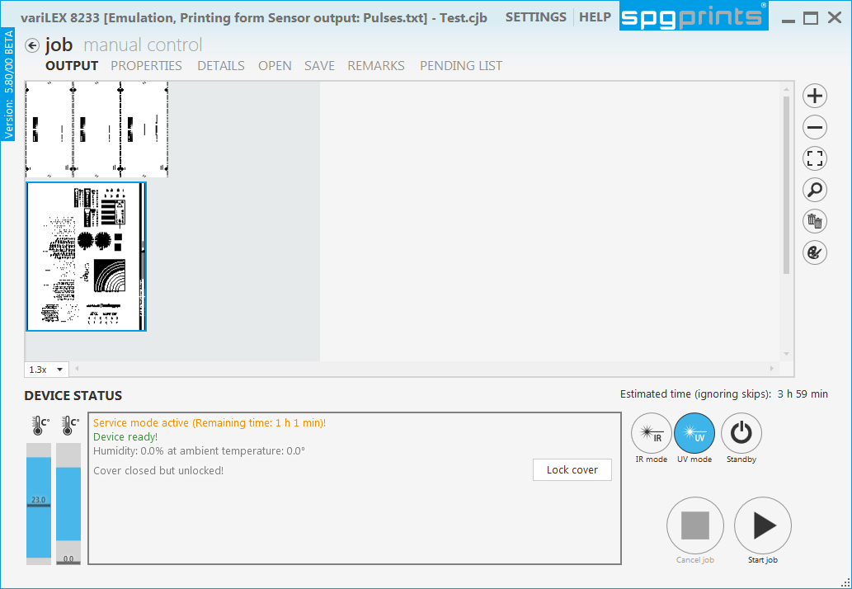
CAM & CAD Stations - Modern UI Style
… for CAM Output on graphical machines
(finite devices)
… for Job Editor on CAD-Stations
With Version 5.80 the CAM-Output Plugin of all graphical devices and the Job editor is presented with the new layout.
Modern UI style
The old style is no longer available. (neither for textile nor graphical devices). This means that all SPG devices are delivered with the new style from version 5.80

Slide 24
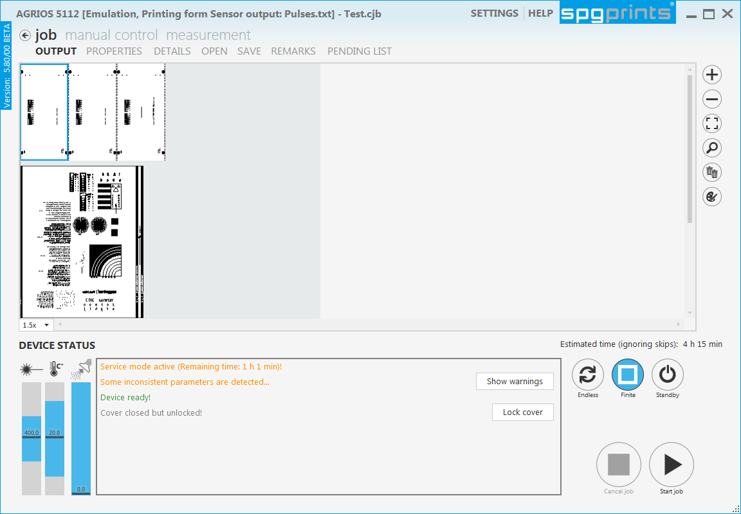
CAM & CAD Stations - Modern UI Style
Handling of the new styled CAM Plugin
Primary the new CAM-Plugin is split into 4 main menus which includes several submenus:
job: set print form properties, create, save, load, start jobs and files.
manual control: move the head, set the focus, test the suction …… (Toolbox)
measurement: measure or analyse the print form.
(Only for devices which are equipped with a measuring sensor)
settings: configure the device settings and checks.

Slide 25
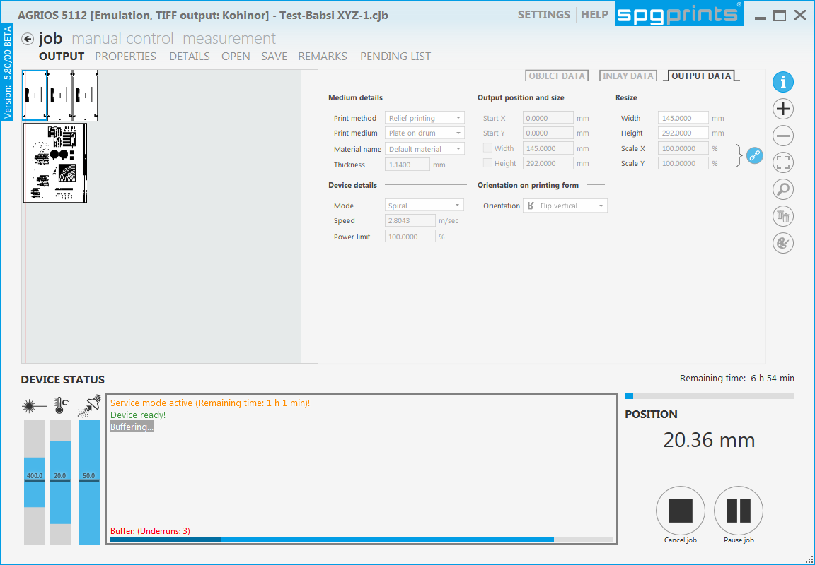
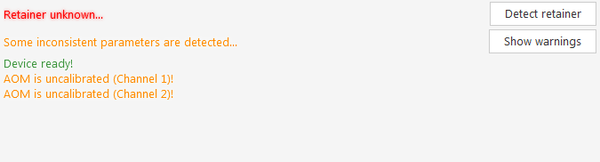
Job - Output
to start, stop or pause the output process,
to detect the correct retainer, show warnings, Lock cover or show the device status in the control panel,
to set device type (finite or endless, IR or UV mode ),
to show and handle the view, output preview, zoom functions …
to activate the “standby” or “power on” mode.
to show the current status of the temperature, vacuum laser power suction or the state …….
after starting the output an Info button appears. A click on this button shows the output parameter during the output process

Slide 26
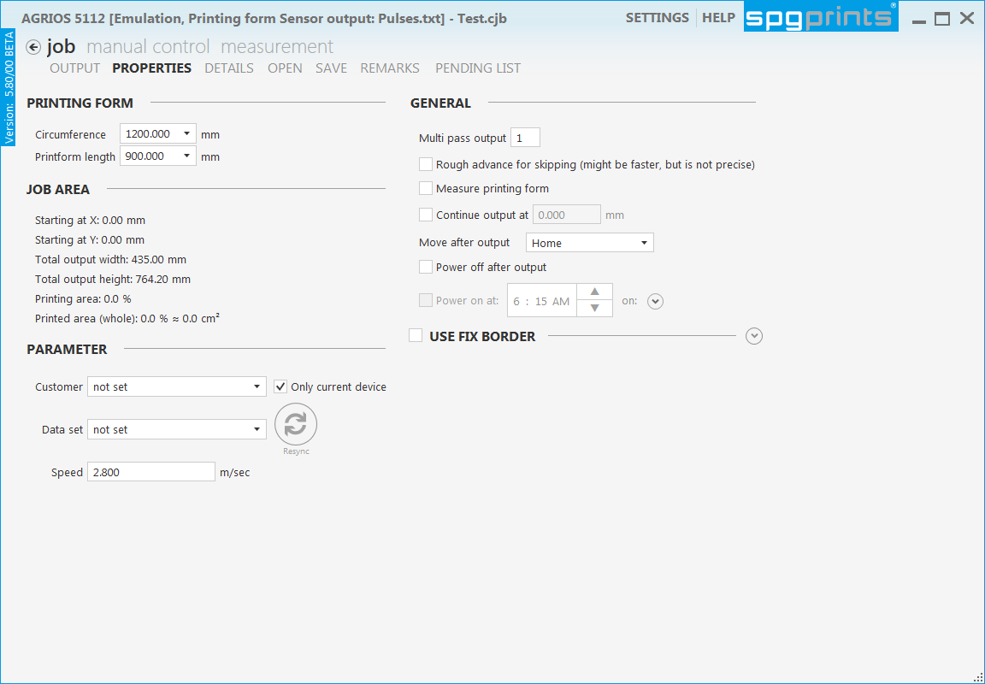
Job - Properties
to set print form data (circumference or length)
to set general output data (Multi pass output, skipping mode, measure print form, Move after output ….
(= “Options” of the old legacy UI)
to shows information about the job area
(= Job information under the Object list of the old legacy UI)
to adjust default parameter for all placed objects (not available with the old legacy UI)
to set fix border or pre engrave border parameter
(in the positioning preview of the old legacy UI)

Slide 27
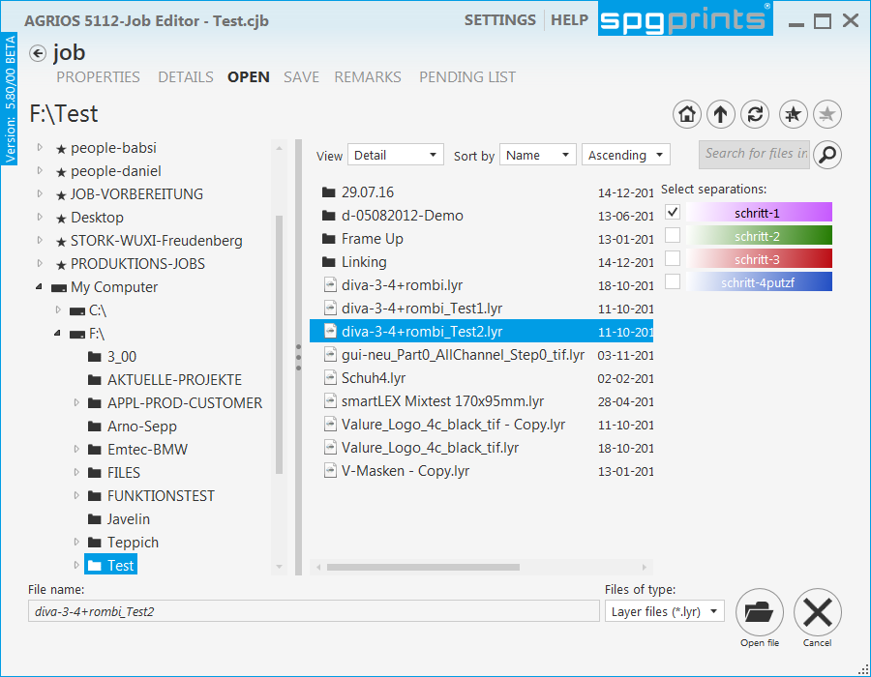
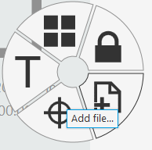
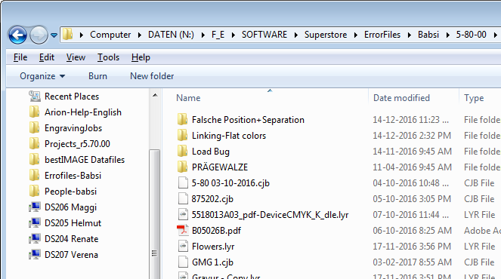
Job - Open
(to open jobs, files, templates or region files)
Click on the tab "Open" or choose in the wheel or popup menu 'Add file' within the view. The contents of the selected folder is shown.
Choose a specified format to limit the display.
Different Views, Navigation buttons and Search functions are available to find files quickly
Click on the displayed “Path” to change
to the Windows Explorer.
All separations of a Lyr file are listed (like PDF) . All activated objects will be loaded and placed into the view.

Slide 28
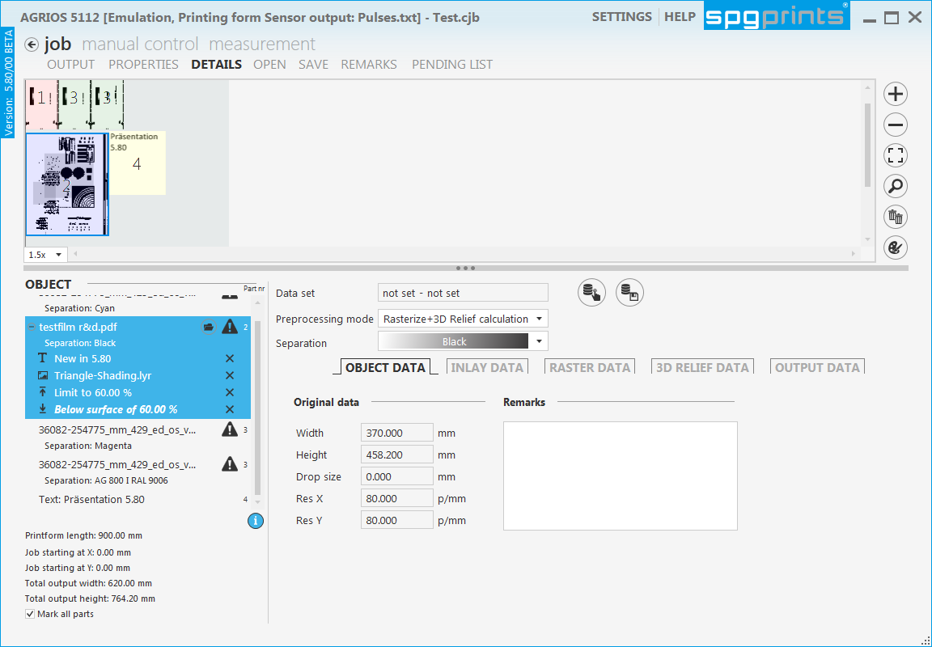
Job - Details
to place and handle objects within the view via context menu
( text - , marking - , file objects )
to load data sets per object
to adjust the output parameter of the objects
(Output data, Object data, Raster data, Relief data, Inlay data ...),
to manage all object within the object list
to get the whole Job area info

Slide 29
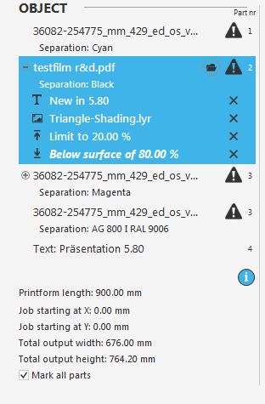
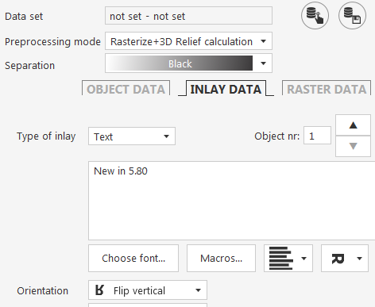
Job - Details: Object list improvements
All placed objects in the view are listed additional in the object list.
With the new “Modern UI style” different features are available.
Separation name of all placed objects will be shown with an active Info dialog
Inlays:
… are listed below the included object.
Inlay types can easily be distinguished by the operator, due to the different icons (text, logo, power limit, below surface).
A click on the icon switches to the “Inlay data” tab to change Inlay parameter quickly.
Fold and Unfold button is available to show or hide the inlays.
They can be removed easily from the object with the X

Slide 30
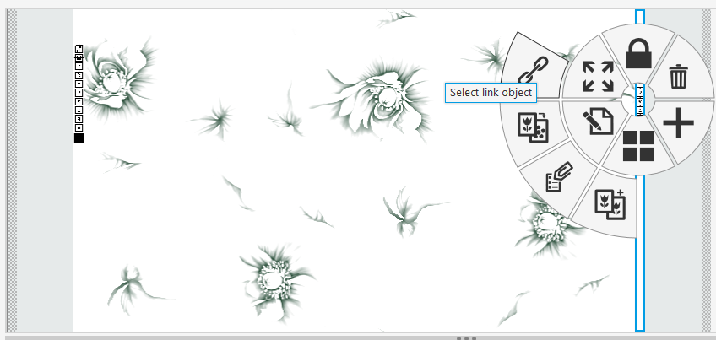
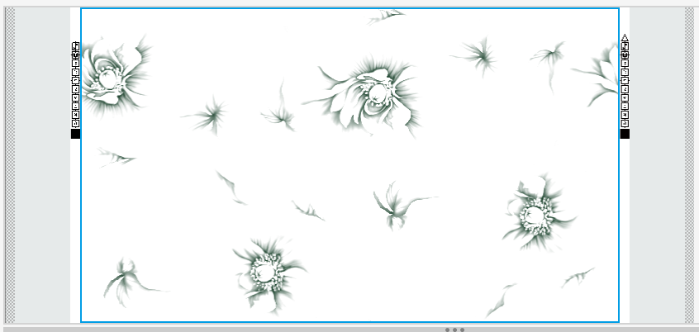
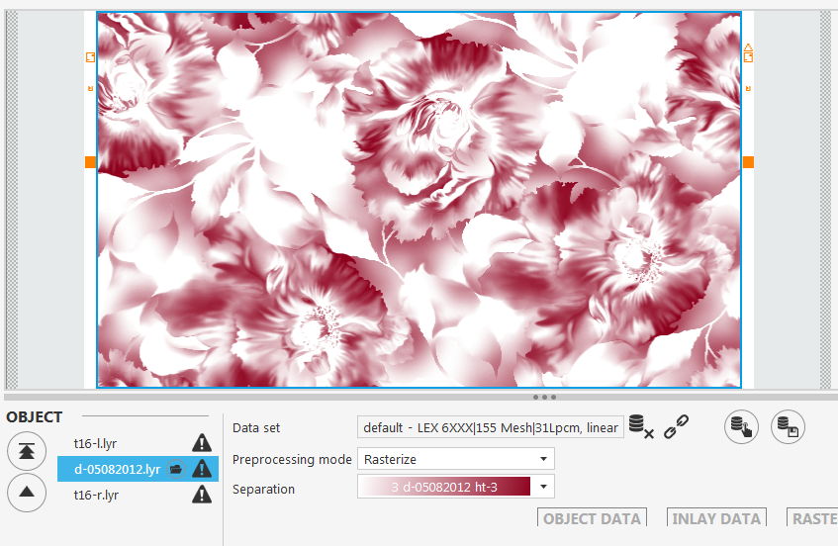
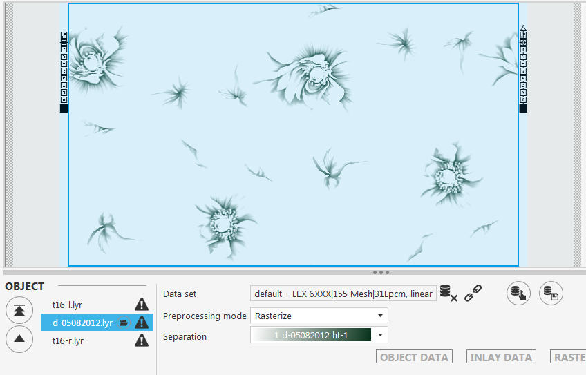
Job - Details: Link File to File
Now it is possible to link file(s) to an other file
An advantage for customer which work with their own picos (=file). If file objects are linked, all separation of different objects can be changed with one click.
Load and place several file objects
Select a file object and activate the menu “Select link object”.
Click on the reference file → Both files are linked now
Shifting the cursor over the view to highlight the connected file objects.
To exchange the separation of all linked file objects switch the separation of the reference object.
separations of all objects
are switched to separation 3

Slide 31
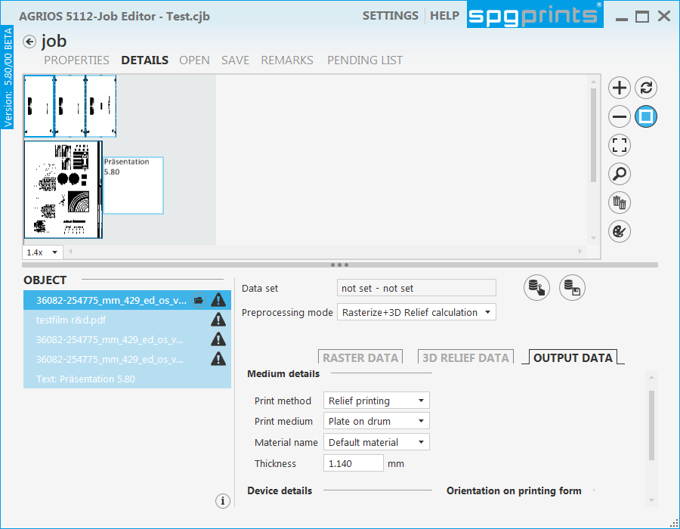
Job - Details: Multi selection
Within the view or object list several objects can be selected to change output parameter of all selected objects quickly.
All selected objects will be coloured with a border in the view and will be highlighted in the object list.
Hold the Ctrl or Shift button pressed and select the objects within the view or object list. (Shift key only possible in the object list)
  Ctrl: Several individual files can be selected.
  Shift: All objects from the first until to the last object will be selected.
Output parameter (Output data, Raster- and Relief data ….) can be set for all selected objects.

Slide 32
Job - Details: Copy/Paste with key's
To duplicate a selected object quickly use “Ctrl+C” to copy and “Ctrl+V” to paste.
The copied object stays in the cache and can be paste several times until an other action was done.
Job - Details: Show Different parts
Active the “Mark all parts” button in the Info list.
Objects with the same part number will be displayed coloured within the view and numbered in the Object list

Slide 33
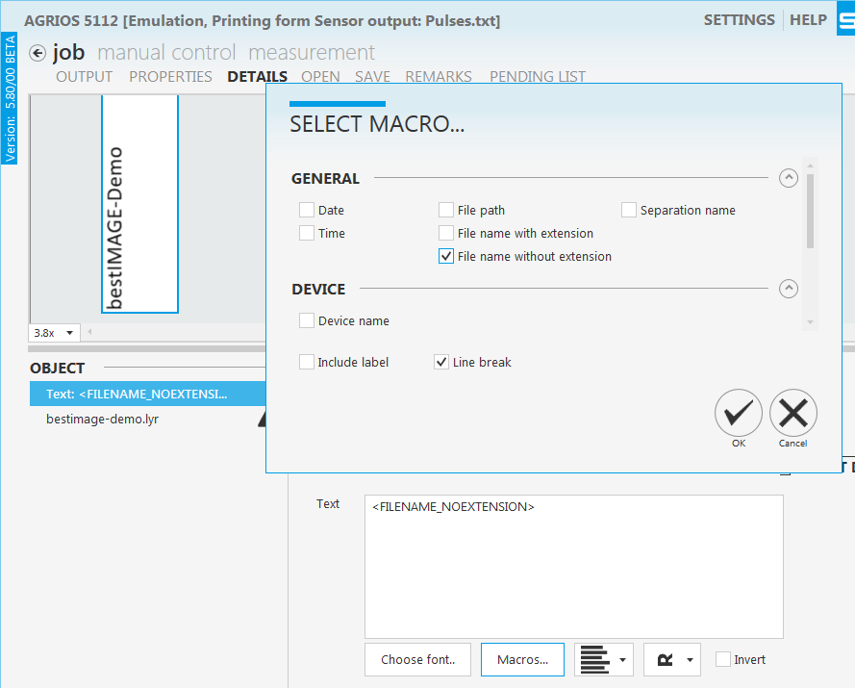
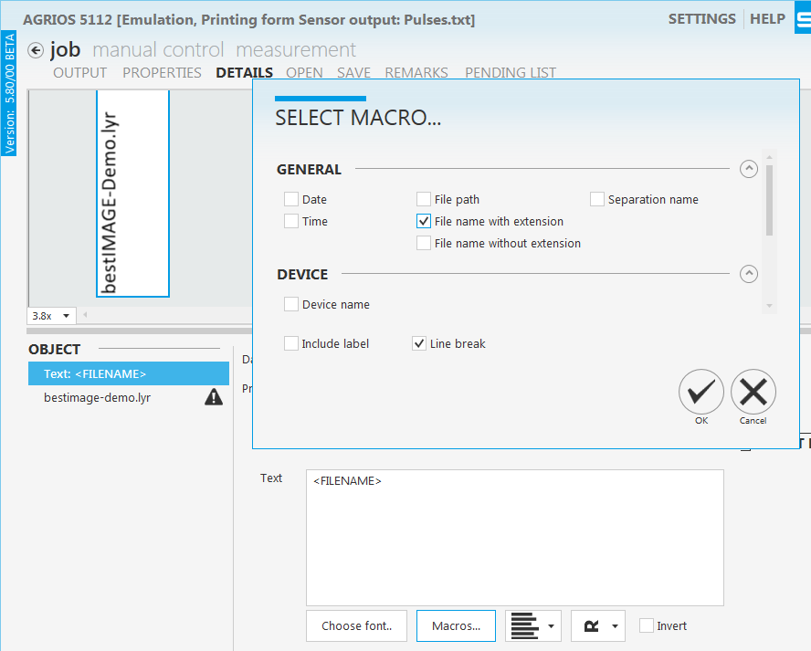
Job - Details: New Macros
Until this version it was only possible to use a Macro “File name with extension”. The extension of the file was additionally output in the linked text object or inlay object.
With version 5.80 a new Macro “File name without extension” was implemented. The extension is not shown.

Slide 34
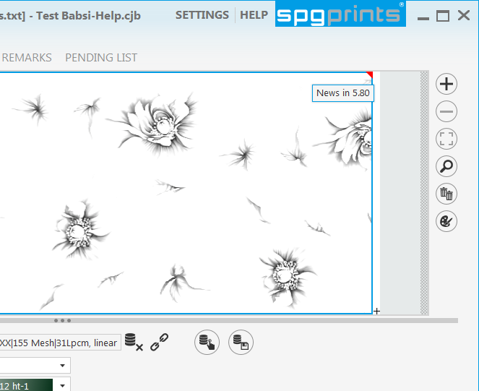
Job - Details: Mark objects with comments
Stored remarks in current file, which were entered and stored in the “File information” or in the "Remarks of Object data" in the CAM-Plugin/Job editor are shown within the view
Loaded Files in the CAM-Plugin/Job editor which includes already stored “Remarks” are singed with a red triangle on the right upper corner. Moving the cursor above the triangle shows the remark.
Remarks which are entered in the CAM-Plugin will be stored automatically into the file after output.

Slide 35
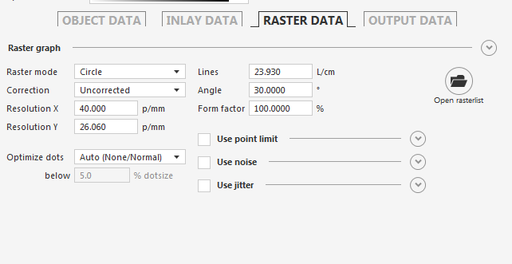
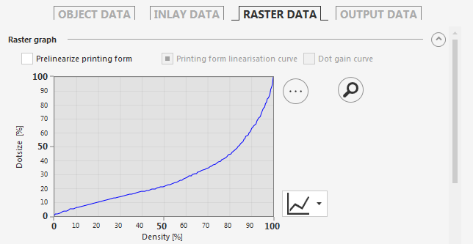
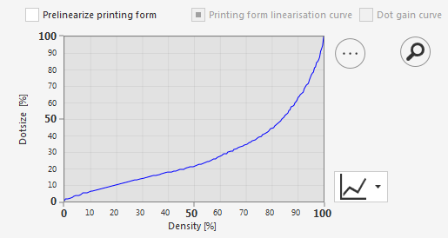
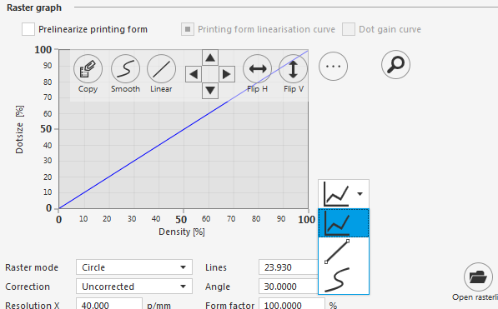
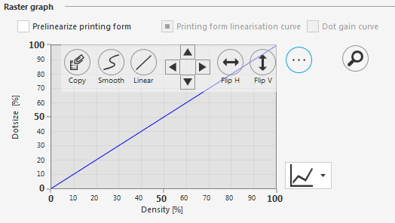
Job - Details: graph handling
To show or hide the graph click on the “Arrow up/down” button. The graph area will be folded or unfolded. Raster parameter are shifted up or down.
To enlarge/resize the graph area click on the magnifier.
To copy, smooth, linearize, move or flip the graph click on the button “…” and activate the corresponding action button.
To modify the graph line choose the corresponding functionality in the drop down menü
Draw a graph line with pressed mouse button within the graph area (default adjustment).
Shift the graph line with handles (linear mode) or insert a value. (a defined number handles are connected with a line these handles can’t be removed).
Shift the graph line via handles (spline mode). Handles can be inserted and removed with key “Delete” or shifting the handle outside the graph area.

Slide 36
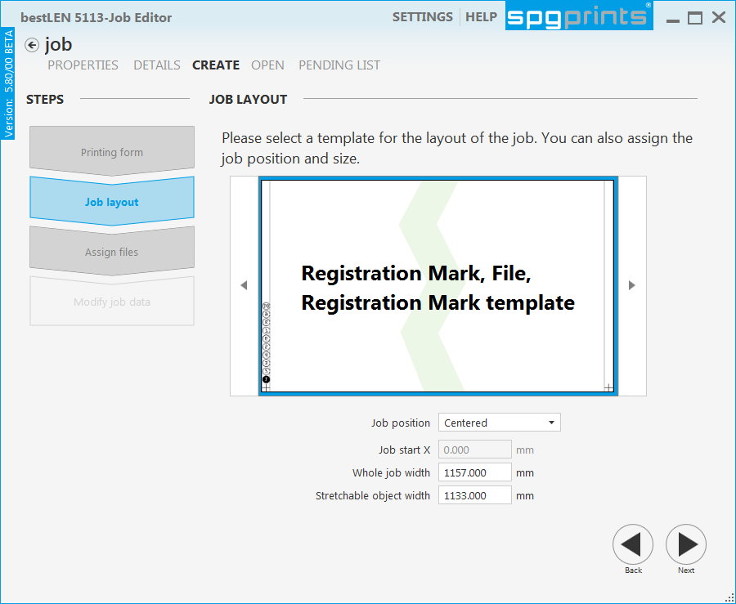
Job - Create (Job Wizard)
In most cases the stretchable object is always the main file which should be output with a specified width.
The width of the of the 'stretchable‘ object can be specified now within the Job wizard.
Type in the width of the main file → the Job width will be calculated automatically and vice versa.

Slide 37
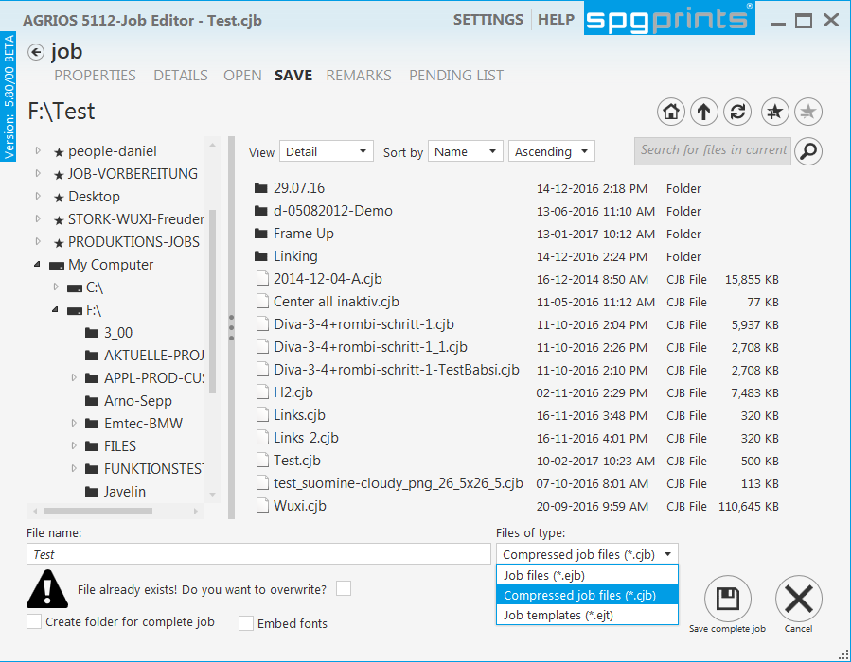
Job - Save
To save a job or template in a specified directory
Click on the “Save“ tab.
Choose the specified file type you want to save.
Choose the directory where the job/template should be stored.
A number (“_Nr”) is automatically appended to the file name if a job/template already exists.
To overwrite the a job/template remove the (“_Nr”)
and activate check box “File already exist! Do you want ……. ?” appears.
_1

Slide 38
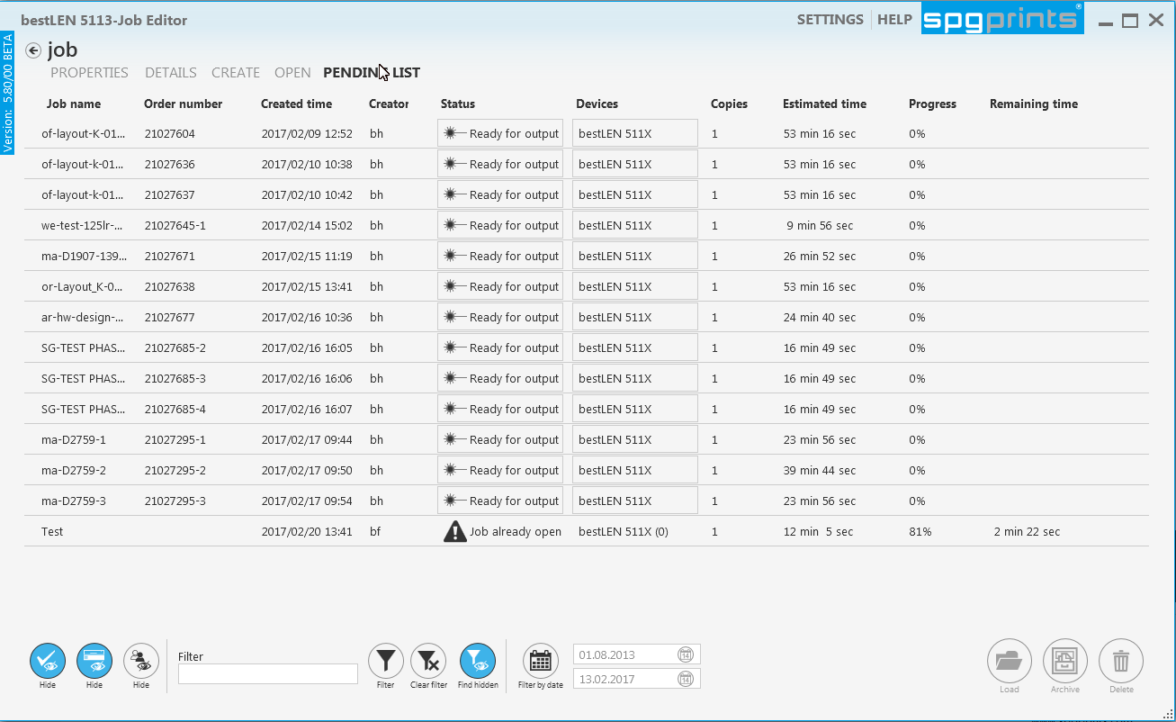
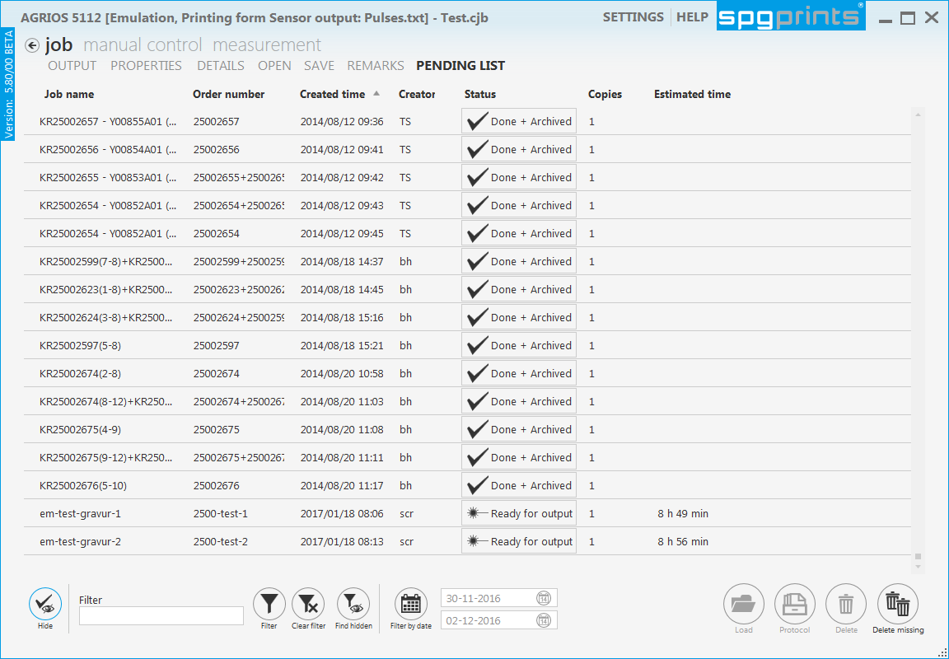
Job - Pendinglist
Pendinglist improvements
Show/Hide jobs of other devices: (only on job – editor)
Find & Search functions: to find jobs quickly in the pending list
Estimated and Remaining time: (only on the job-editor)
Both times are shown during output on the job editor.
Estimated time shows the whole output time
Remaining time is displayed during the output and shows how long the output is still in progress.
Archive jobs manually: Already "done" jobs which were not automatically archived can be archived manually in the Pending list of the job editor with the "Archive" button after output.

Slide 39







Job – Pendinglist – Show/Hide jobs of other devices
Show/Hide done jobs | Finished output jobs with the state "done" will be shown or hidden in the list
Show/Hide jobs of other machines | Normally all jobs of different devices are visible on the job editor. Only jobs of the chosen device are visible with an active button.
Show/Hide jobs of other user | Stored Jobs of different workstations can be shown or hidden on the job editor
Job Pendinglist - Find & Search Functions
Filter | Type in the full or a part of the Job name or Oder number and click on "Filter". Only Jobs which are correspond to the searching name are listed.
Clear Filter | Clear Filter removes the entry in the filter field. All Jobs are listed.
Find hidden | The search functionality has also influence onto hidden jobs. If hidden jobs corresponds the searching criteria they will be listed.
Filter by date | To filter jobs according their creation date. The Region of shown jobs can be limited by specifying the start and end date.

Slide 40
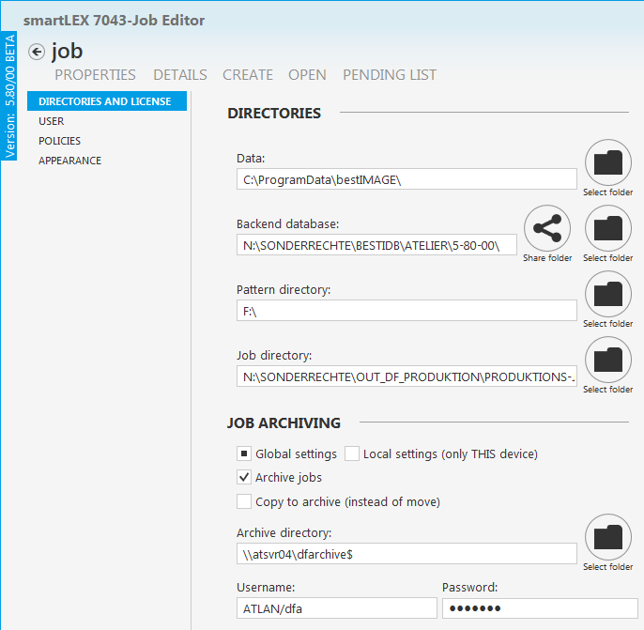
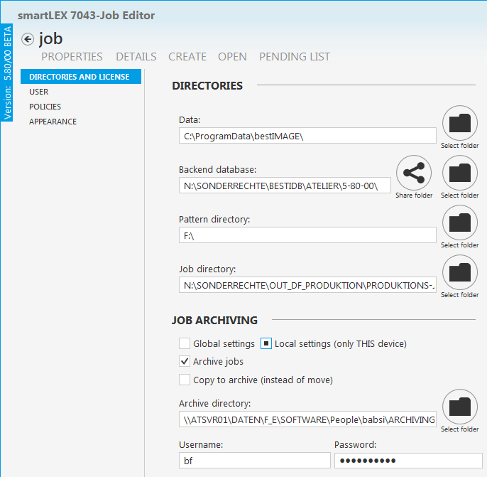
Settings - Archiving improvements
  Global settings → Local settings (only as privileged user)
  Up to now all connected devices have gotten the same adjustments if the archiving parameters have to be changed in on one connected CAD or CAM-station.
  Now it is possible to set:
  “Global settings” (Archiving parameters for all connected devices) and
  “Local settings” (only parameters for the current station)
  Both data sets will be stored into the Pendinglist.db to be able to change between Global und Local adjustments quickly.

Slide 41
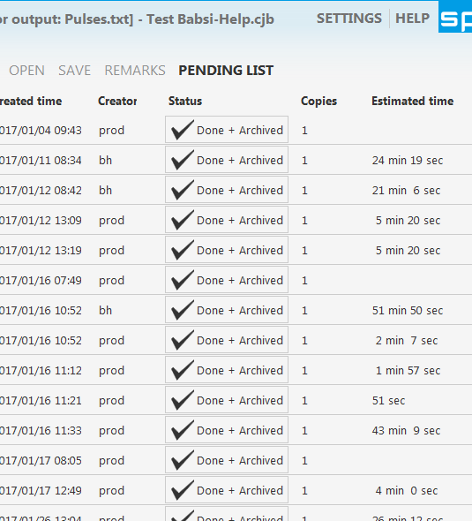
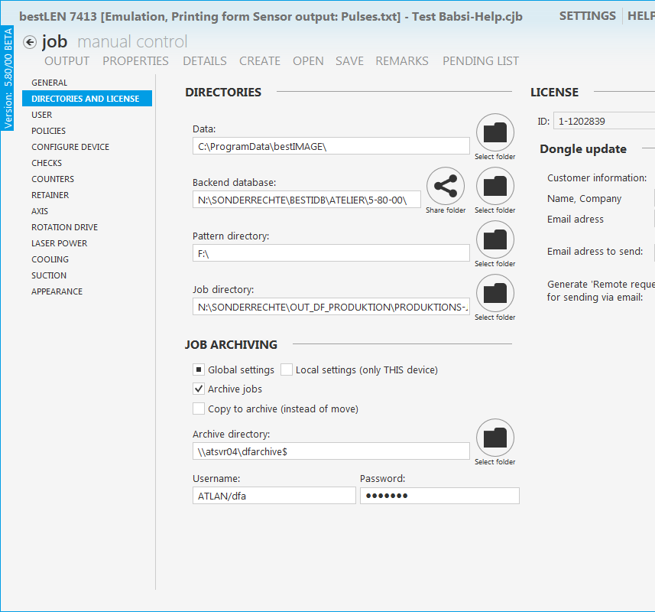
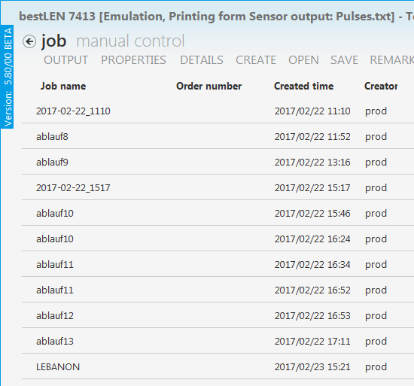
Settings – Archiving Improvements
  Automatic Job-Archiving after it`s done
  Listed jobs in the “Pending list” are automatically archived to the defined Archive server in the Settings.
  Not saved jobs which are assembled directly on the device are also archived with an automatically generated Job name (<YYYY-MM-DD_HHMM>). .
  After the output directly created jobs are added to the Pendinglist.
  Archived Jobs get the state “done/archived” and stay available for repeat order.

Slide 42
Settings - Policies
New Policies with Version 5.80
    No Y scaling: Y scaling is locked.
    The object can not scaled in Y direction. The Scale Y entry field in the “Output data” of the Detail view is deactivated.
    Fill empty spaces automatically:
    During reloading a Job empty areas are filled with a place holder object. (special features for smartLEX )
    Use popup menu as list:
    Instead of the function wheel menu a popup menu is displayed within the Detail- /Output view
    Use regions:
    With an active button, regions can be set. “Add regions” is deactivated in the Wheel or Pop up menu. In spite of an inactive button already stored Jobs which includes a region can be loaded and output.
    Use text, marking or inlay objects:
    With an active button it is possible to set "text, marking or inlay objects”. The "Text data, Marking data or Inlay data" tab will be shown under Details.
    In spite of a inactive button old Jobs which include already "text, marking or inlay objects”. can be loaded and output but not changed.

Slide 43

Settings - Policies 5.70/09
Default value for below surface of Inlays
To set inlay objects immediately onto “below surface” by default in the CAM-Output Plugin
    With 5.50 inlay objects were always output below surface (none printing). Except for digital output.
    With version 5.60 the mode “on top” was additionally implemented as default, because this mode is always available (for digital & analogy).
    Now with an active policy “Default value for below surface of Inlays”, the inlay objects will be set to “below surface” additional with the predefined output depth by default.
    This mode will be set back onto “on top” if “below surface” is not possible because of the set parameters. A message will be shown in the warnings if below surface is possible but not set !

Slide 44
CAM------------------------------------------------
CAM

Slide 45
Contens Page 6 (CAM Station)
  CAM Station:
    Job Reports is presented with new Modern UI Style Page 46
    Smart LEX: File Handling improvements Page 47
    Manual calibration of DLX and variLEX beside automatic calibration (in IR-mode) 5.70/07

Slide 46



CAM- Job Reports Is Presented with new Modern UI Style
With Version 5.80 the Job Report is presented with the new layout too.
Modern UI style
All started Jobs and their state will be shown in the “SEARCH REPORTS” tab as list.
All output parameter of the selected Job will be shown in the “VIEW DETAILS” tab. Doubleclick on Job should switch to Detail view. Print button also in the detail view
A detailed Output parameter about the selected object are shown in the respective tab of the
“Job data ” and “Object data”
The statistic of all jobs will be shown in the specified tab. Several individual statistics can be shown by changing the adjustments. (Date, Job status, …..)

Slide 47

CAM- SMARTLEX File handling improvements
During changing the separation a „Question dialog“ appears. Click on …
Change separation only:
If a data set is set: The adjusted raster curve of the dataset will be loaded during changing the separation.
If no data set is set: The raster curve of the previews separation will be used during changing the separation.
  Attention:
  If the you change from a flat to halftone separation. The flat raster curve of the flat separation will be taken over to the halftone separation if no data set is set.
Keep position: With this mode the stored curve in the lyr file will be loaded

Slide 48
CAD------------------------------------------------
CAD

Slide 49
Contens Page 7 (CAD Station)
  CAD Station:
    Frame up: Multiframe with different sizes (UI redesign) Page 50
    Edit: Rotate Vector objects with “keep position”: Page 51
    Color replace Page 52
                Inside gamut of ….
                Calculation and display dE, dE1994, dE2000 and CMC

Slide 50


CAD - Frame Up
Multiframe with different sizes (UI redesign)
  Several colours with different sizes can be increased. All Base colours (=Colours which should be de-/increased) are visible in a separate list.
    Drag the “Base colour” from the “Frame up colour” list or “Colorinfo” into the “Base colour” list.
    Activate the checkboxes onto the colors you want to frame up
    → Individual (click on the checkbox) or
    → All selected (black frame) with popup menu “Set selected”
    Select several “Frame up colors” (black border) in the “Frame up colour” list with additional shift (from … to) or ctrl key (individual)
    Set the same frame sizes for all selected frame up colours (black border).
    Set the different frame sizes for each frame up colour in the specified field
    With an active proportional button Size Y is equal to Size X.

Slide 51



CAD - Edit
Rotate Vector objects with “keep position”:
Original file: Placed Vector objects
Rotation of all vector objects without
“Keep position”
Rotation of all vector objects with
“Keep position”

Slide 52


CAD - Color Replace
Only inside gamut ……
  Color book colors within a specified gamut can be assigned to replace free colors of a design.
    With an active check box “Only inside ….. Gamut” (monitor, printer, user defined LAB gamut or recipe) only colors of the chosen color book which correspond to the adjustments in the replace function will be assigned
Calculation and display dE, dE1994, dE2000 and CMC
  Additionally to the color gamut ranges dE (1967) and CMC following color ranges are available.
  dE 1994
  dE 2000

Slide 53
Service-------------------------------------------
Service

Slide 54
Contens Page 7 (Service)
Service
    Service password → Privileged user Page 55
    Pendinglist improvements (only for privileged user) Page 56
                Delete Jobs from list
                Delete missing
                Order number improvements
    Archiving settings Page 58
    Adjustable retainer detection speed (5.70/08)
    Enable low resolution output (5.70/06)
    Configuration of an Info Service for SMTP Page 59
    Smart Template improvements Page 65

Slide 55


Service - Set Privileged User password
Service user → Privileged user
  With service password (Service user) it is possible to generate a password for a “Privileged user” to give them access to change some settings which were only possible with service password up to now.
    To set a password for a privileged user you might have a service access before in the “USER” tab
    Click on “Change password for privileged user”. A dialog opens to specify and repeat the password for the privileged user.
    → Now you have privileged access to change some parameters in the Policies, the Directories & License, General, User, Counters (Activated carbon or Particle filter: “Show warning if ablated material is more than ), Channel settings tab.

Slide 56


Service - Pendinglist Improvements
Delete jobs from list
    Already "done" or “done+archived” jobs can be removed from the pending list only with administrative rights.
Delete missing
    Missing jobs in the job directory or archive directory are marked red in the Pending list
    With administrative rights all missing jobs will be removed
    from the list with click on the “Delete missing” button .

Slide 57

Service - Pendinglist Improvements
    Order number:
    Privileged user or user with administrative can adjust following Job policies to:
    Force order number of jobs: Entering a job number is absolutely necessary after switching the state from "under construction" to "ready for output“.
    Order number length (min., without prefix): Determines the minimal order number length in the pending list. A Warning is shown, if the specified length in the Pendinglist corresponds not the with the adjustment in the Policy.
    Use order number prefix: Same characters which are specified as prefix are set automatically at the beginning of an order number.

Slide 58
SErvice - Archiving settings
  Archiving adjustments
  Listed jobs in the “Pending list” are automatically archived to the defined Archive server in the Settings.
  Archived Jobs get the state “done/archived” and stay available for repeat order.
  Archive tree structure is
  <YYYY.MM.DD>/<Order#>/<Job files> (if order number is present)
  <YYYY.MM.DD>/<HHMMSS>/<Job files>
  For the archive location the system uses a dedicated archive account with a password. This prevents users to modify the
  archive manually. To adjust archive setting is only possible with service access or a user with privileges.

Slide 59






    SERVICE - Configure an Info service for SMTP
    Create a Google G-Mail account
  The Info Service for bestIMAGE CAM can be used to send related job information like status and errors to operators via Email. Sending an email is the most common way. With this example the free Google's GMail SMTP server will be used to configure an Info service via SMTP.
  Google's GMail SMTP server is a free service for anyone who has a GMail account. You can use this free SMTP server to send emails from your favourite web application.
  Click on “Create an account”. It is recommended to create a “dummy” account only for this purpose.
  Enter an email address and password as you like. It is recommended to create a “dummy” account only for this purpose
  Login to the just created GMail account
  Click the round button on the right corner of GMail webpage and on the button “My Account”.
  Click on “Sign-in & security”
  Scroll down to “Connected apps & sites” and change “Allow less secure apps: to ON
  Log out rom your Gmail account.

Slide 60




    SERVICE - Configure an Info service for SMTP
    Setting up the Info Service for an E-Mail
  Start bestIMAGE and open the “Ouput Plugin”
  → Info Service is only available in the “Expert user interface”
    Get “Service access”
    → To configure the “Info Service” for bestIMAGE you need service access.
    Activate under “Settings->User” the “User Info Service”.
    Click on “Server settings” button to open the Info Server Settings tool.
    Click on “smtp server->Add” to add a new SMTP server.
    Enter Google Gmail SMTP Server settings and use your Gmail account “username” and “password” you have created before and click on “Apply”.

Slide 61

    SERVICE - Configure an Info service for SMTP
    Test the email configuration
  Click on “Send test email” to test the connection to the server.
  Enter the target email “address” you want to send a test email, select the “smtp host” and a “text” you want to send.
  Click on “Send test email”.
  Check the mailbox (in our case: max.franz@abc.com) if email has been sent.

Slide 62


    SERVICE - Configure an Info service for SMTP
    Add the operator which should be informed
  Click on “Add” to define operators which should be informed via E-Mail.
  Enter the operator name (1) and e-mail or Phone number (2) and the used Service (3)
  The entry of an active checkbox (4) informs the specified user via e-Mail or SMS.
4
1
2
3

Slide 63

Service - Adjustable retainer detection speed 5.70/08
  With version 5.70/08 it is possible to configure the drum speed individual per device under “Settings-Configure Device” to adjust different detection speeds for different heavy drums. Because heavy drums need longer to reach the defined speed.

Slide 64

    SERVICE - ENABLE LOW RESOLUTION OUTPUT (5.70/06)
Enable low resolution output
  With an active “Enable Low resolution” output it should be possible to create quickly a spiral file onto the print form.
    Inserting a Raster resolution below 5 p/mm is possible.
    The raster mode is automatically switched to “2 Level” after inserting a low raster resolution.
    (automatic switching is only possible if the raster mode is “not fixed” or “fixed for 2 Level” and “Same Res Y as Res X” is not active within the Policies)
    To save jobs with low raster resolution (below 5p/mm) is not allowed to prevent a archiving of “wrong” Jobs

Slide 65

Service - smart templates improvements 5.70/03
Align objects (left/right)
  With version 5.80 it is possible align files to the next left or right object to prevent empty areas between files.

Slide 66

Service - smart templates improvements 5.70/03
Fix objects in templates
  Now it is possible to fix file objects in the template.
  Fixed file objects will be loaded automatically (can’t be changed) during creating a Job via wizard and using a stored template with fixed files.
  Advantage for customers which use always their own and same file objects as registration marks.
  Attention:
  Fixed files and smart Templates have to be copied into the “C:\ProgramData\bestIMAGE” directory to be able to use the template via Job-Wizard.

Slide 67
Thank you for your attention

